Slide 1
The Need for a
Sustainable Budget
Bradford G. Keithley
Partner, Perkins Coie LLC
Meet Alaska
Alaska Support Industry Alliance
January 11, 2013

Slide 2
Key Points
Alaska’s current fiscal future is highly uncertain
The risk of instability undermines long-term investment
  Who wants to invest in an uncertain fiscal climate (creating an uncertain tax structure)
Finding a solution to fiscal instability is key to maintaining long-term investment

Slide 3
ISER January 2013
“Right now, the state is on a path it can’t sustain. Growing spending and falling revenues are creating a widening fiscal gap.”
“Reasonable assumptions about potential new revenue sources suggest we do not have enough cash in reserves to avoid a severe fiscal crunch soon after 2023, and with that fiscal crisis will come an economic crash.”

Slide 4
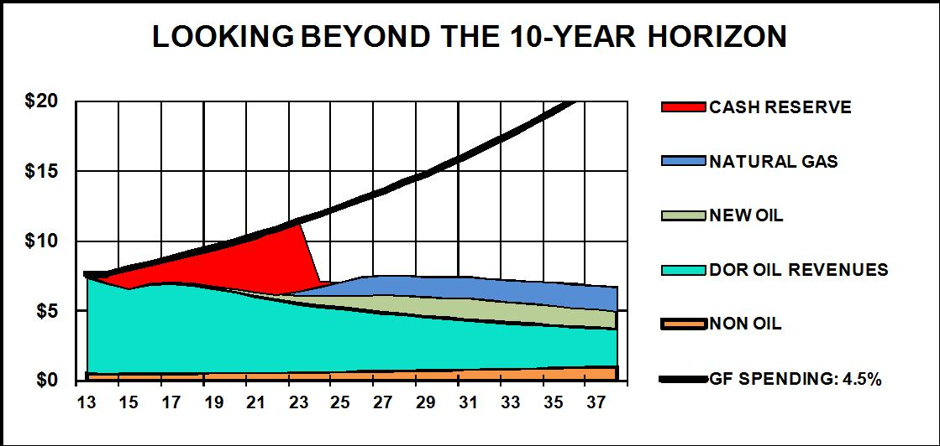
“The figure … shows the growing General Fund fiscal gap—even assuming new revenues from natural gas production and more oil production—if spending increases at a rate of 4.5% annually. “

Slide 5
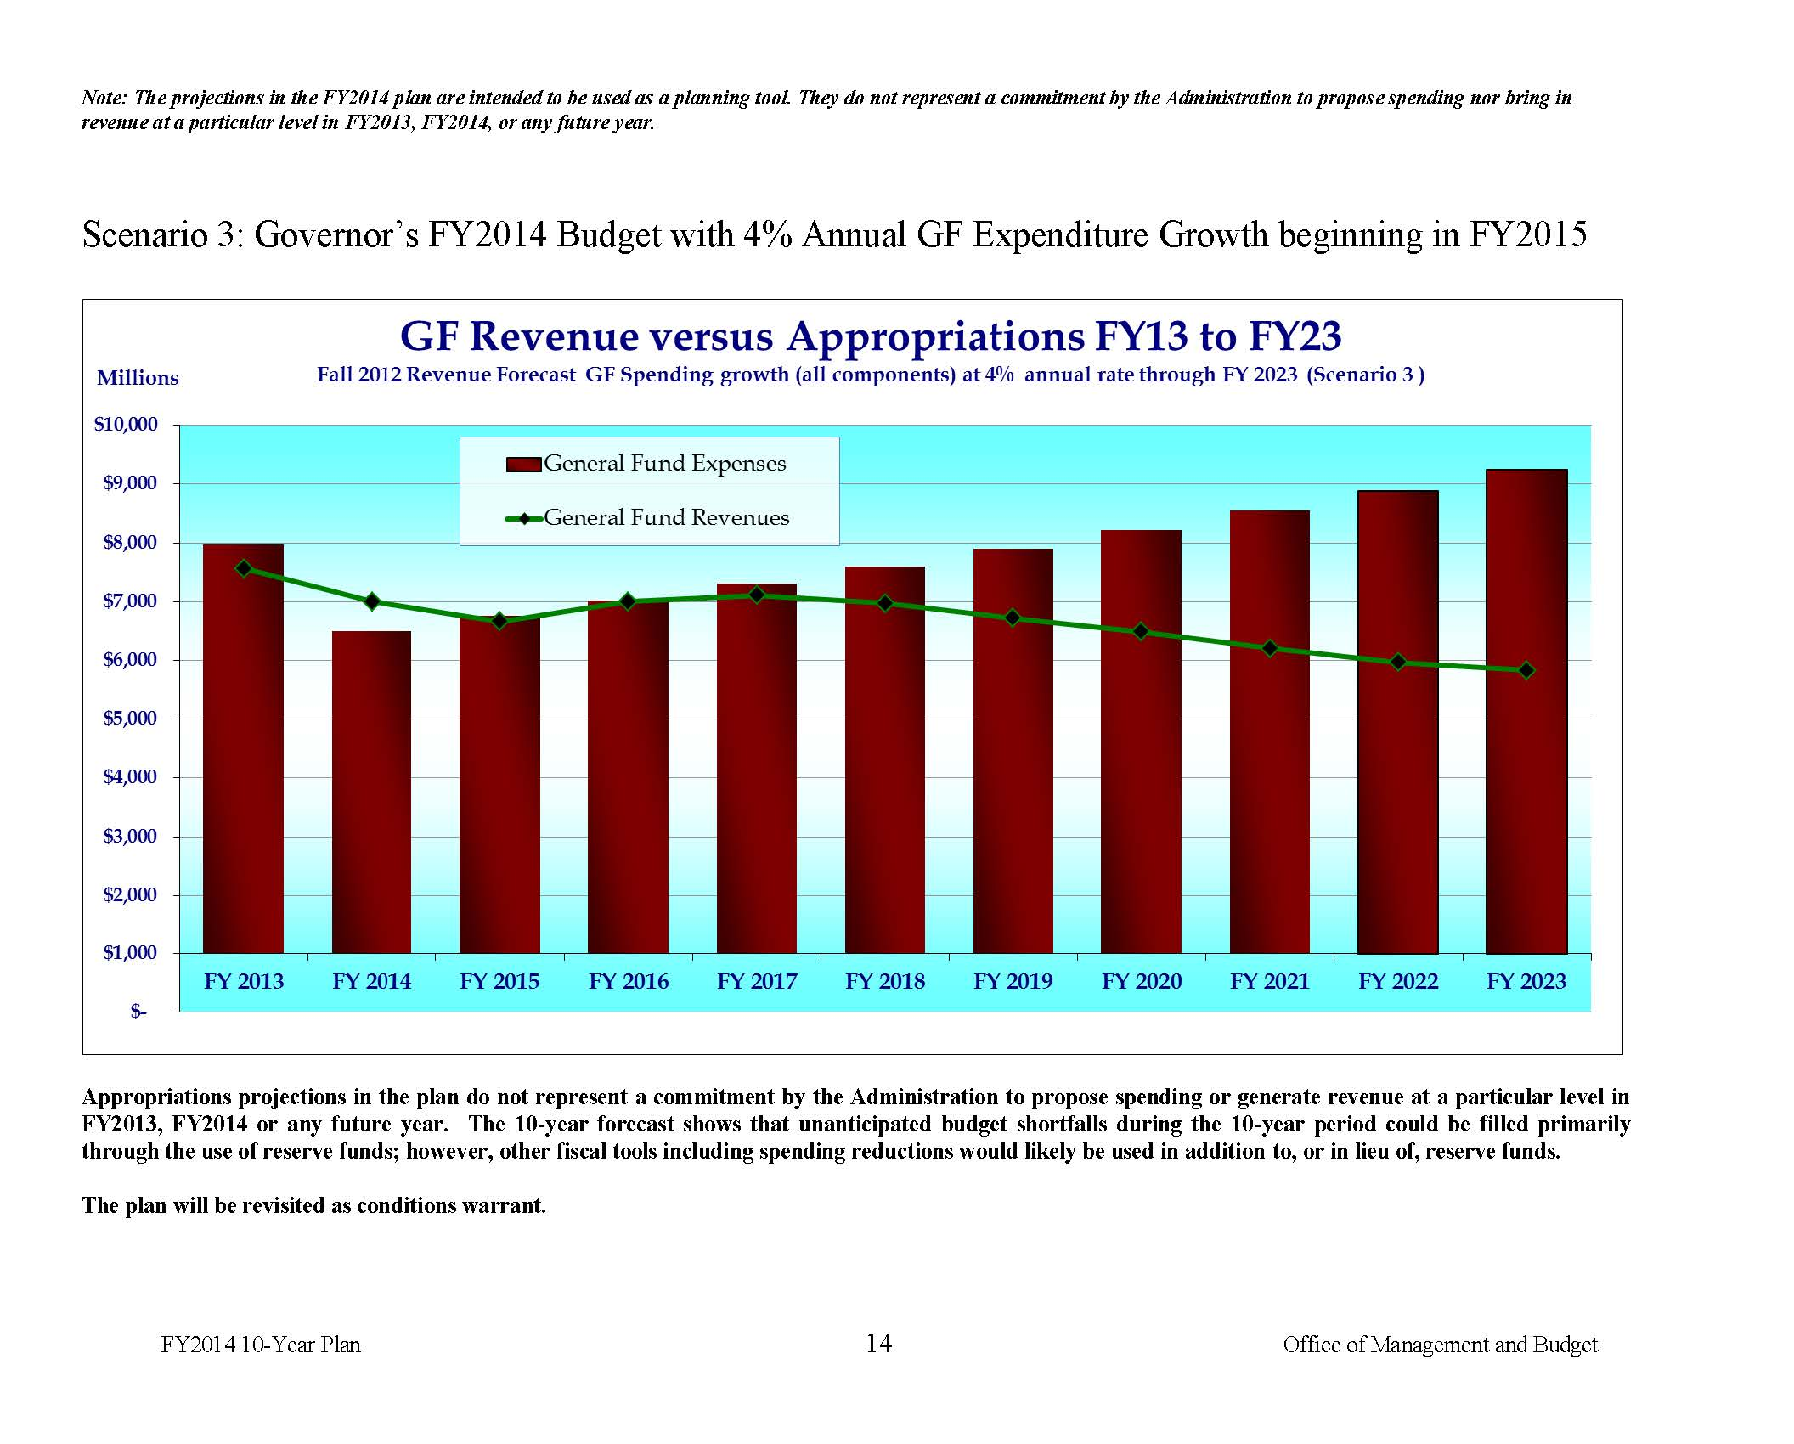

Slide 6
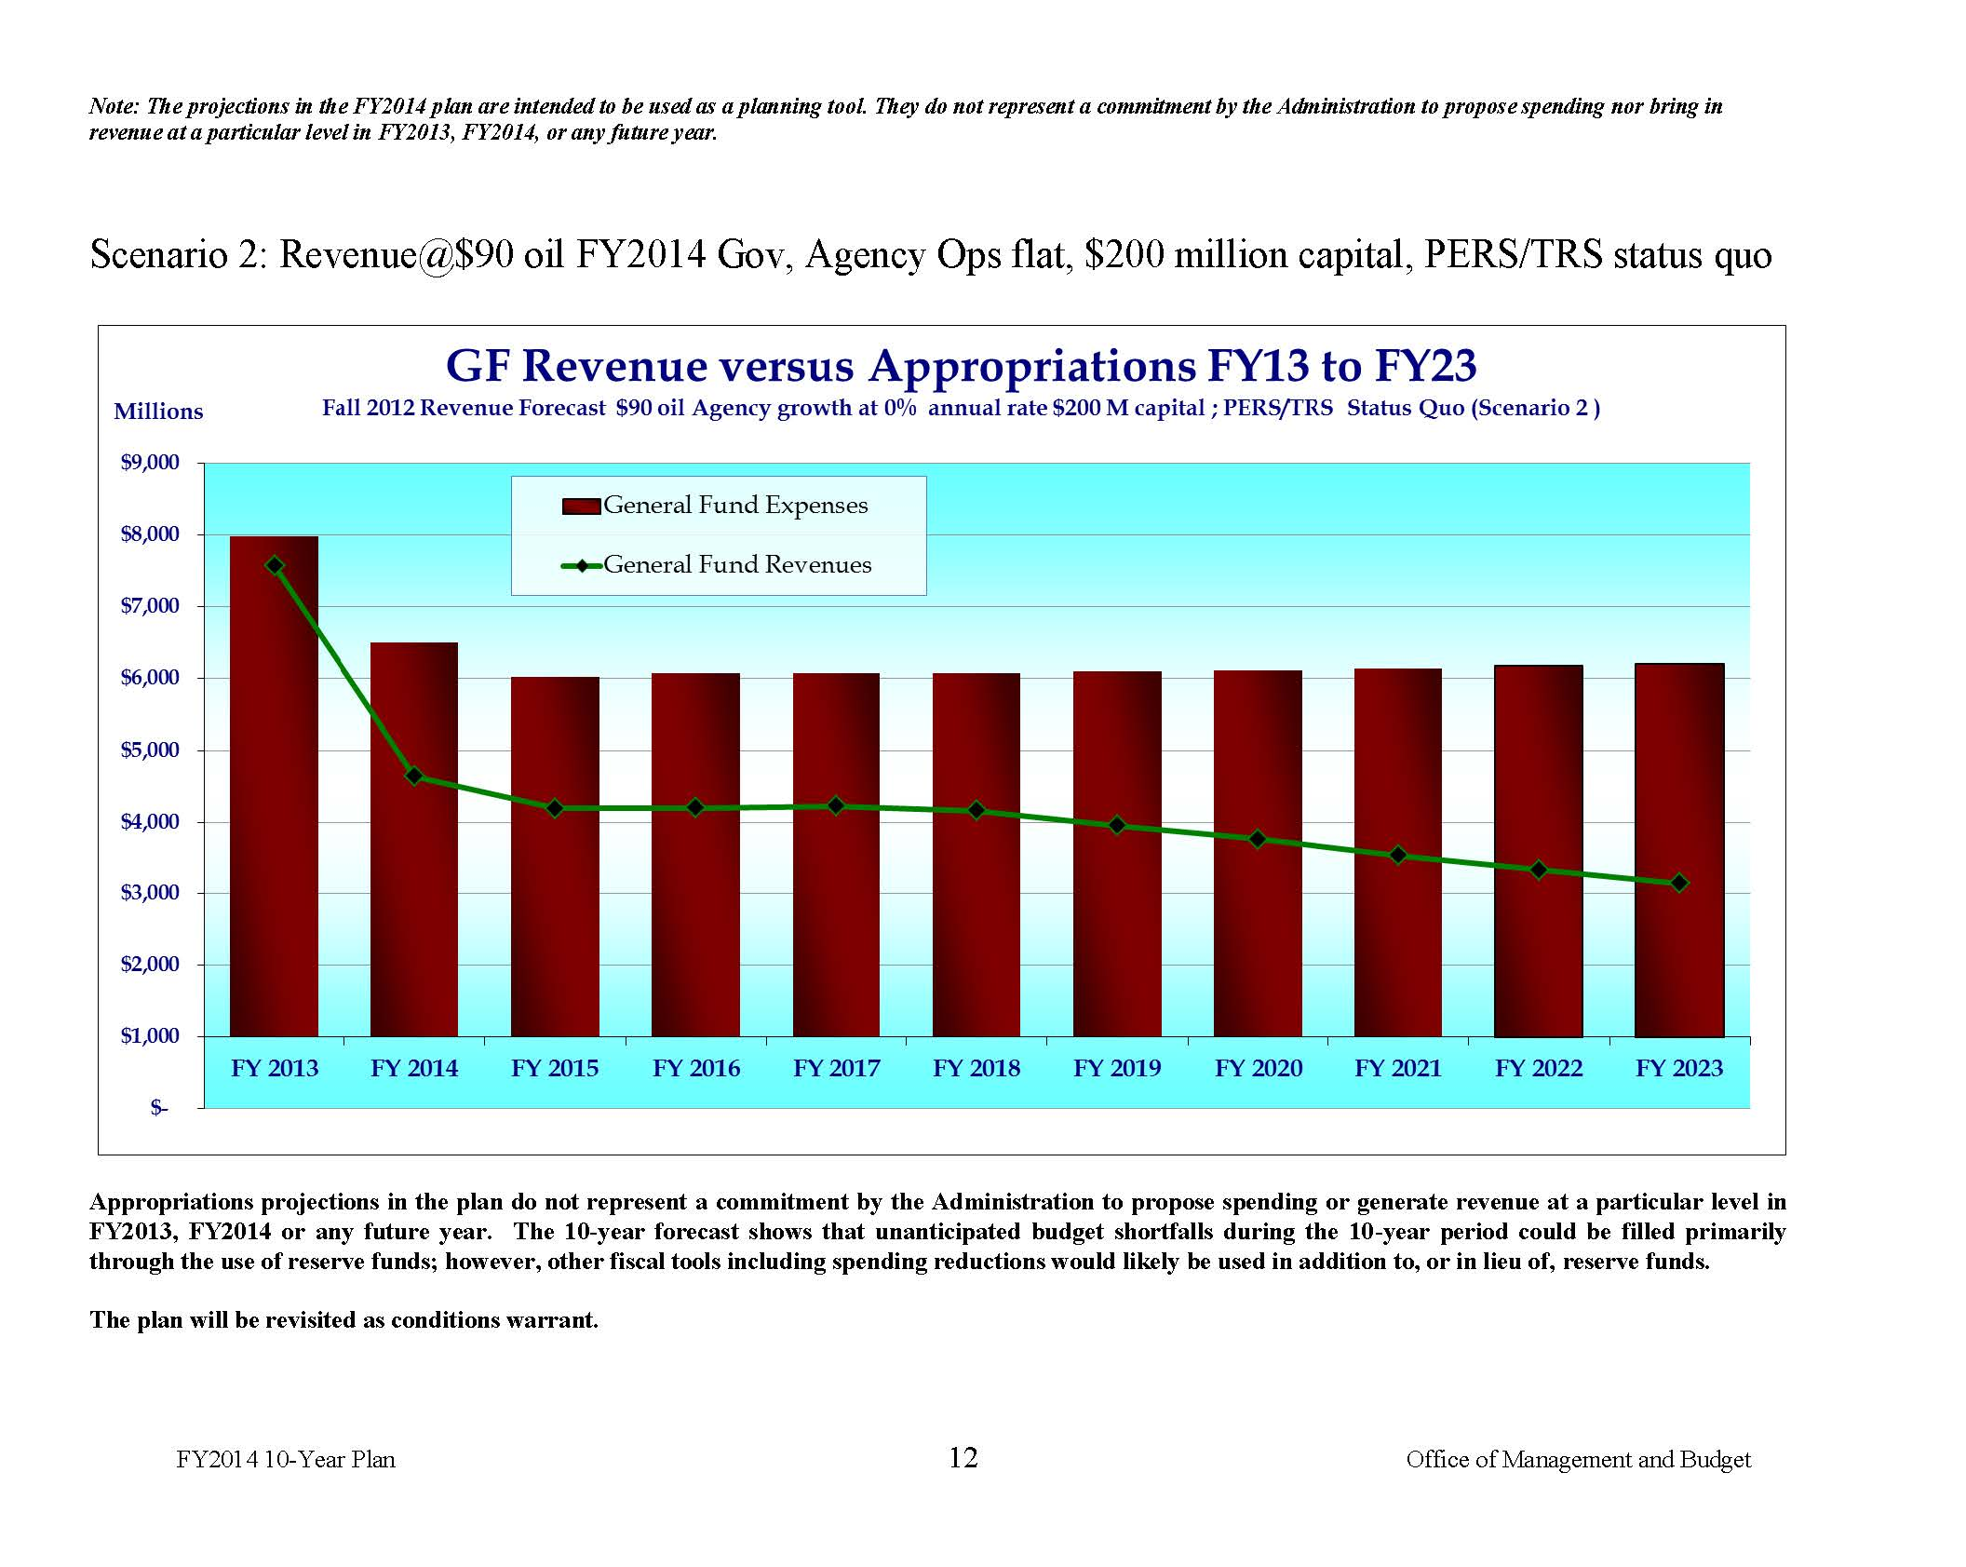

Slide 7
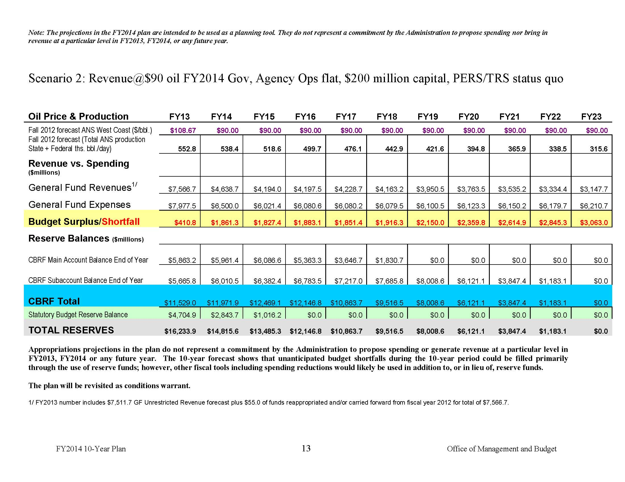

Slide 8
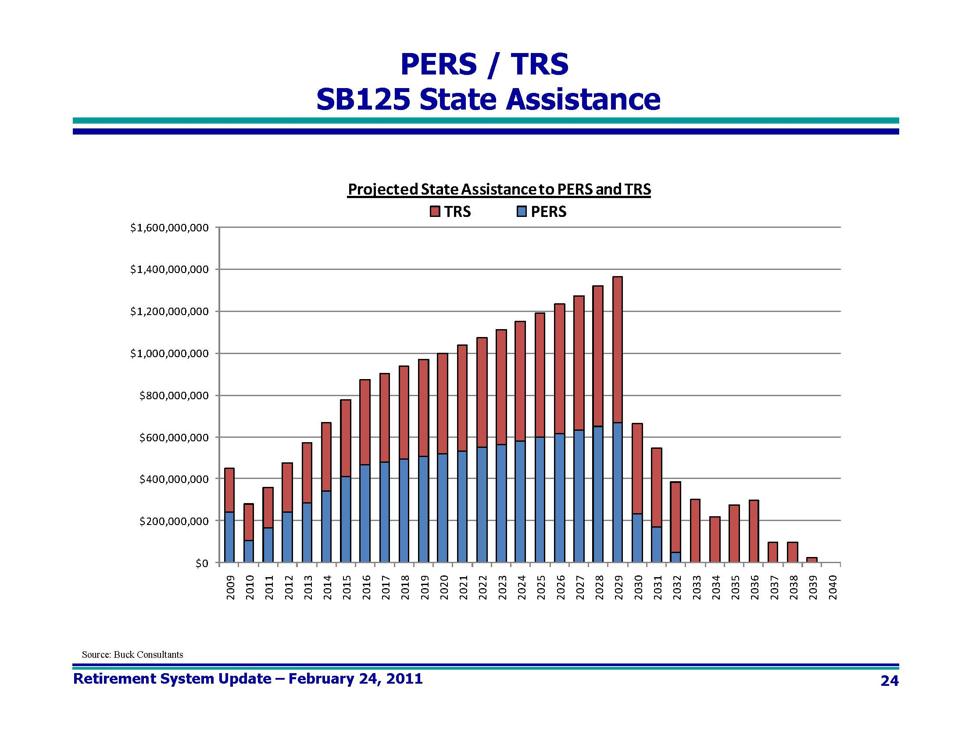

Slide 9
ISER January 2013
“What can the state do to avoid a major fiscal and economic crisis? The answer is to save more and restrict the rate of spending growth. … the state needs to sharply step up its savings rate, starting now.”
“In fiscal year 2014, Alaska’s state government can afford to spend about $5.5 billion.”

Slide 10
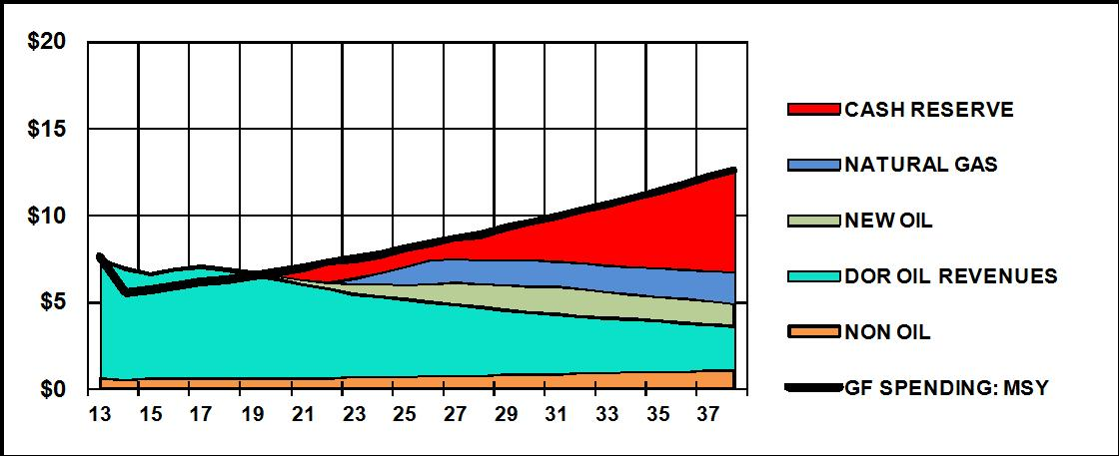
“All revenues above the sustainable spending level of $5.5 billion—including Permanent Fund income except the share funding the dividend—would be channeled into savings.”

Slide 11
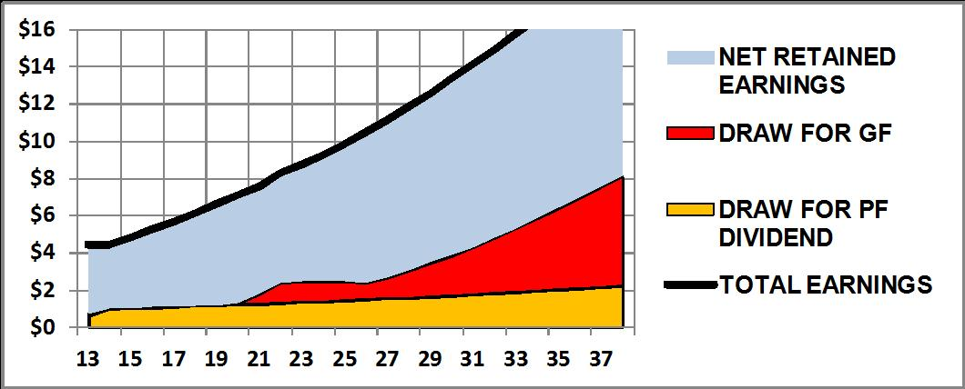
“On this sustainable path the combined earnings of all the financial assets … would initially all be reinvested, except the amount set aside to pay the Permanent Fund dividend …. The financial assets would gradually become the most important source of revenues for the General Fund ….”

Slide 12
It won’t be easy …
Governor’s
Proposed Budget
ISER Calculated Budget
$6.5 B | Proposed FY2014 Budget
+ .5 B | “Legislative Priorities”
$ 0 | Savings
$5.5 B | ISER Calculated FY2014 Spend
$1.5 B | Savings

Slide 13
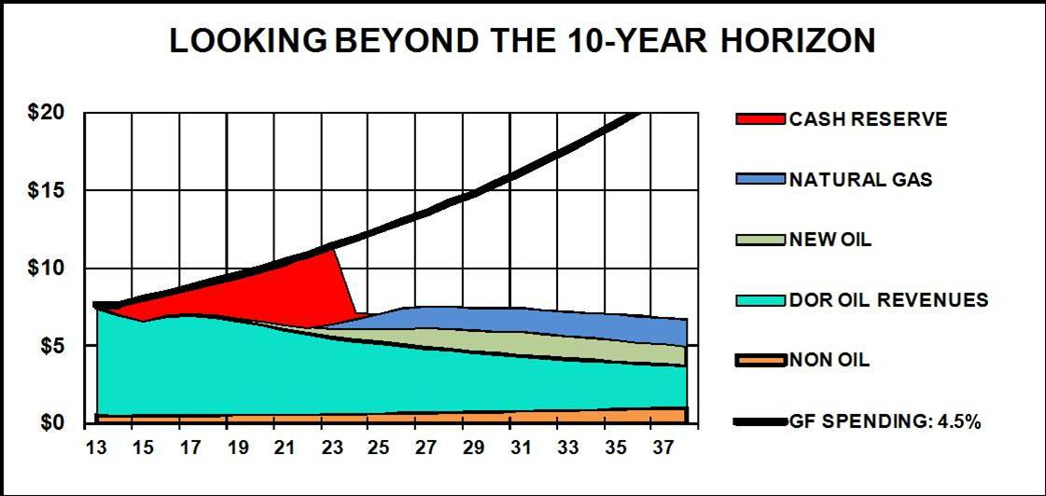
But it is necessary …
The risk of instability undermines long-term investment
  Who wants to invest in an uncertain fiscal climate (creating an uncertain tax structure)
Adopting a sustainable budget is as important to attracting and maintaining long-term investment as oil reform

