Slide 1
Alaska OCS Development:
What’s next from the perspective of investors?
Bradford G. Keithley
Perkins Coie LLP
Anchorage, Alaska & Washington, D.C.
Energy in Alaska
December 3, 2010

Slide 2
Overview
Where is Alaska OCS development now
What are the next steps in OCS development
What are the issues ahead

Slide 3
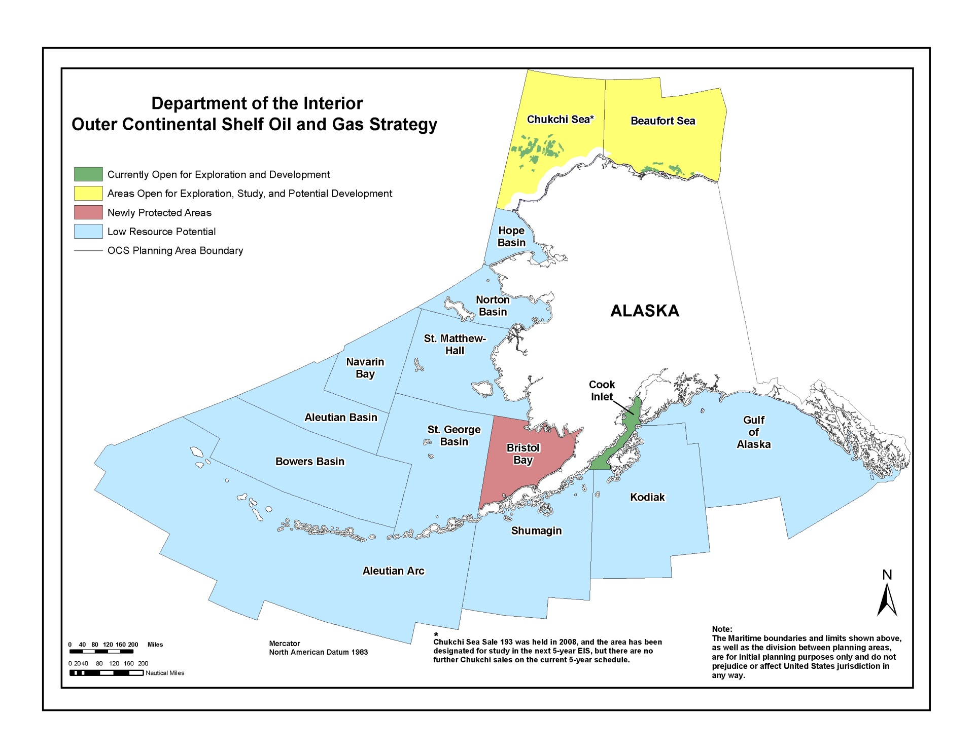

Slide 4
Where is development now
Prior drilling
  Chukchi: 5 exploration wells in the 1980’s (all capped and abandoned)
  Beaufort: Approximately 30 exploration wells in the 1980’s & ’90’s (production from man-made islands)
2008 Alaska OCS Lease Sale
  Shell, ConocoPhillips and Statoil primary bidders
Shell’s exploration experience this summer
  Accomplishments
    Two top holes drilled (one each in Chukchi and Beaufort)
    Lessons learned (sea ice, whaling, containment vessel)
  What carries over to next year
    Drilling to hydrocarbons

Slide 5
Where are the others
ConocoPhillips (Chukchi)
  Has submitted an exploration plan to BOEM which anticipates exploratory drilling in 2014
  Exploration plan currently under review
Statoil (Chukchi)
  Recently announced deferral until at least 2015 (“We will not be drilling in 2014, and we have not made a decision to drill … We are obviously watching the process that Shell's going through.”)
BP (Beaufort)
  Liberty development deferred

Slide 6
What are the next steps
If exploration identifies commercial quantities
  Development program
  Production facilities
  Transportation facilities
Each step depends on exploration results and will require detailed planning
Each step also requires several permits; each permit – at least the major ones – may be litigated (differs from Norway)

Slide 7
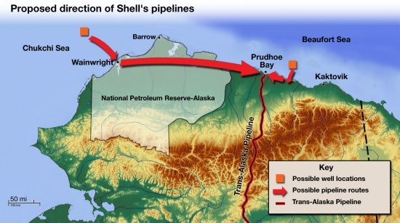
Next steps/New issues
Pipeline routing
  If exploration identifies commercial quantities, pipeline routing will become important (300+ miles Chukchi/TAPS; significant cost issues)

Slide 8
Next steps/New issues
Additional acreage: 2012-17 OCS lease sale
  Alaska OCS included, but “targeted approach” in Alaska OCS (compared to areawide leasing approach in Gulf of Mexico)
  “Targeted” tracts not yet identified (“maximize the availability of oil and gas resources … while minimizing potential conflicts with environmentally sensitive areas and the native Alaskan communities that rely on the ocean for subsistence use.”)
  Anticipates Alaska OCS leasing will occur in 2016 (Beaufort) and 2017 (Chukchi) (deferred one year from preliminary plan)
  Further litigation likely once “targeted” areas identified

Slide 9
What other issues are ahead: royalty
Currently, Alaska receives
  100% of the royalty from production within 3 miles of the coastline, 27% in production from 3 - 6 miles offshore, 0% at 6 miles and beyond
  Production beyond 3 miles is exempt from production tax ("ACES")
  Shell's Beaufort prospect is 18 miles offshore; its Chukchi prospect is 70 miles offshore
Alaska delegation has argued for parity with Gulf states and communities (which split 37.5%)
  Incoming Senate Energy & Natural Resources Chair Ron Wyden (D – Ore.) has indicated some sensitivity, but
  Conflicts with federal deficit issues

Slide 10
Conclusion
OCS development at an early stage
A long way to go before “first oil (or gas)”
Because of absence of royalty sharing, a question of “what’s in it for Alaska”

